Slide 1


DATA Science INTERNSHIP
TASK 2 PAYTM EPURCHASE ANALYSIS

Slide 2
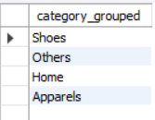

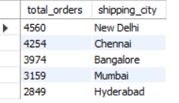
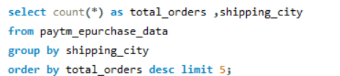
1) What does the "Category_Grouped" column represent, and how many unique categories are there?
2) Can you list the top 5 shipping cities in terms of the number of orders?

Slide 3
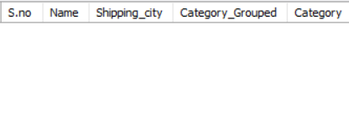

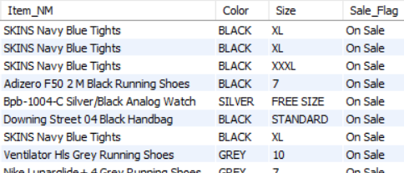

3) Show me a table with all the data for products that belong to the "Electronics" category.
4) Filter the data to show only rows with a "Sale_Flag" of 'Yes'.

Slide 4
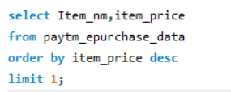

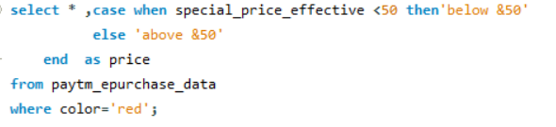
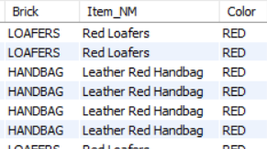
5) Sort the data by "Item_Price" in descending order. What is the most expensive item?
6) Apply conditional formatting to highlight all products with a "Special_Price_effective" value below $50 in red.

Slide 5

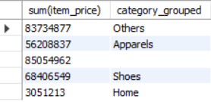
7) Create a pivot table to find the total sales value for each category.

Slide 6
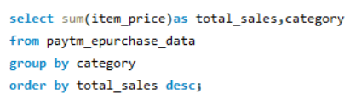
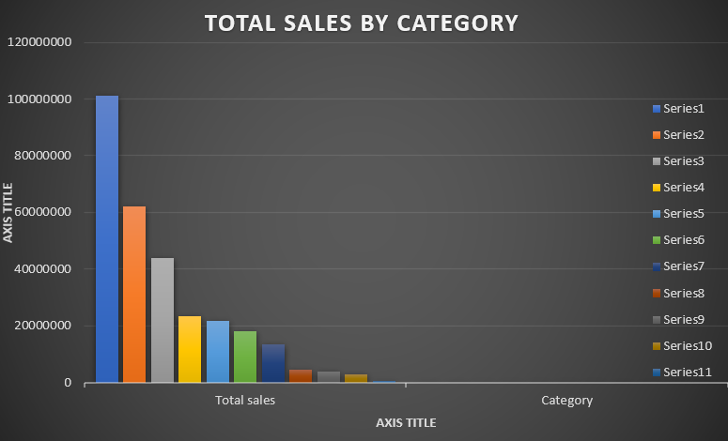
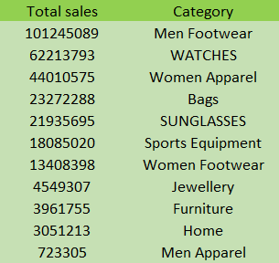
8) Create a bar chart to visualize the total sales for each category.

Slide 7
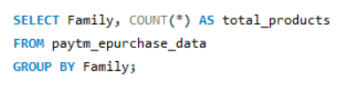
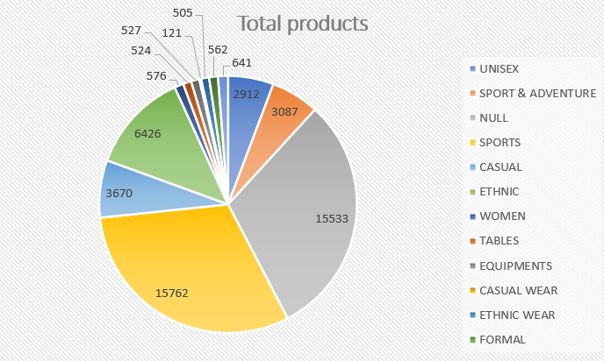
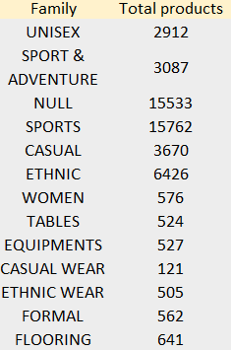
9) Create a pie chart to show the distribution of products in the "Family" category.

Slide 8
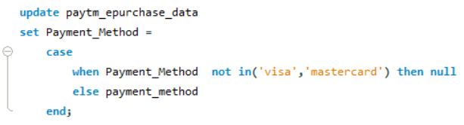
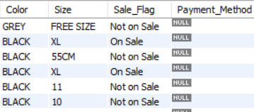
10) Ensure that the "Payment_Method" column only contains valid payment methods (e.g., Visa, MasterCard).

Slide 9


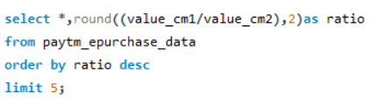
11)Calculate the average "Quantity" sold for products in the "Clothing" category, grouped by "Product_Gender."
12)Find the top 5 products with the highest "Value_CM1" and "Value_CM2" ratios.

Slide 10
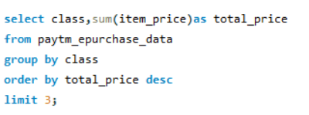
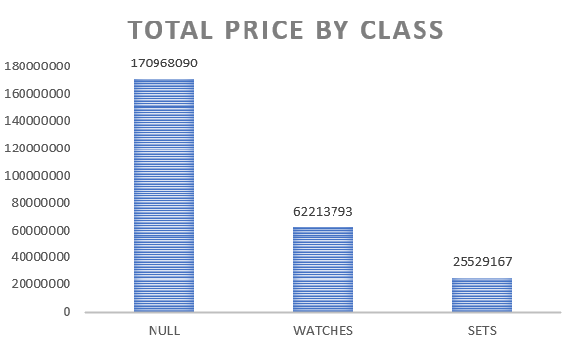
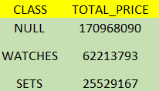
13)Identify the top 3 "Class" categories with the highest total sales. Create a stacked bar chart to represent this data.

Slide 11


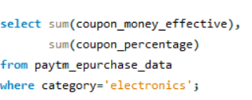

14)Use VLOOKUP or INDEX-MATCH to retrieve the "Color" of a product with a specific "Item_NM."
15)Calculate the total "coupon_money_effective" and "Coupon_Percentage" for products in the "Electronics" category.

Slide 12
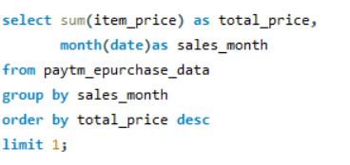
16)Perform a time series analysis to identify the month with the highest total sales.
(Date information was not available in the source)

Slide 13
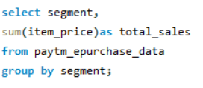
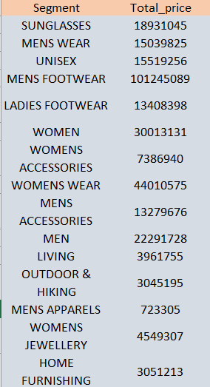
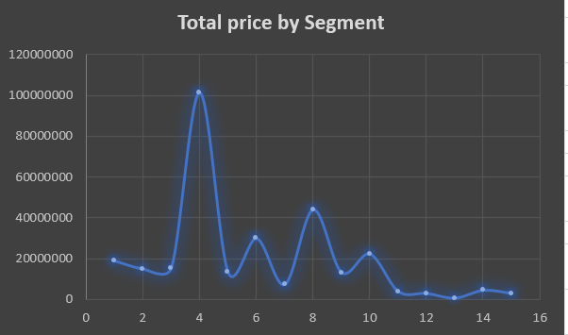
17)Calculate the total sales for each "Segment" and create a scatter plot to visualize the relationship between "Item_Price" and "Quantity" in this data.

Slide 14


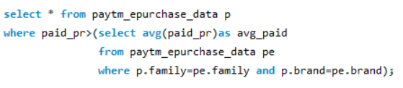
18) find the average "Item_Price" for products that have a "Sale_Flag" of 'Yes.'
19)Identify products with a "Paid_pr" higher than the average in their respective "Family" and "Brand" groups.

Slide 15
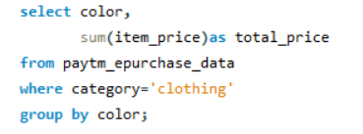

20)Create a pivot table to show the total sales for each "Color" within the "Clothing" category and use conditional formatting to highlight the highest sales.

